Slide 1
Slide sample Questions online format
MCQ-type questions
  For some: more than one correct answer: labeled ‘(mark all boxes that apply)’
Open questions: few word answers
Selection questions

Slide 2
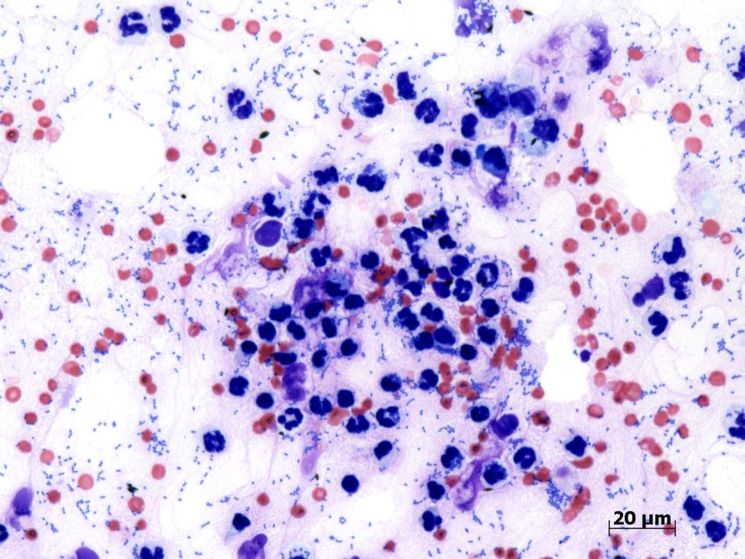
1) Vitreal aspirate, 7yo German Shepherd dog
What is the most likely diagnosis (mark all boxes that apply)?
Bacterial hyalitis
Ocular lymphoma
Posterior lens capsule rupture
Metastatic haemangiosarcoma

Slide 3

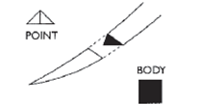


2a) Surgical needles
1
Name the needle types:
1
2
3
4
Correct answers
1 Round bodied
2 Cutting
3 Reverse cutting
4 Spatulated
2
3
4

Slide 4
2b) Surgical needles
1
Of needle types 1 to 4, select the most appropriate for the following tissues:
Cornea
Conjunctiva
Eyelid
Correct answers
4
1
3
2
3
4

Slide 5
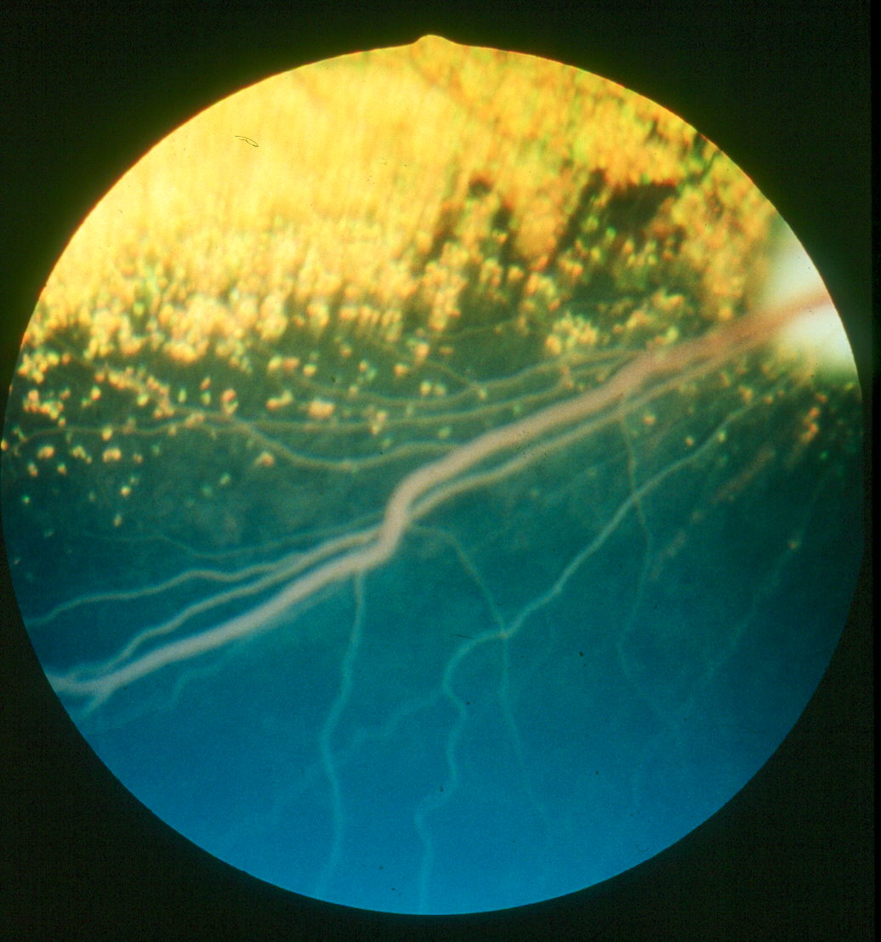
3) 3yo Min poodle, bilateral changes
What is the correct term for this condition?
Answer
Lipaemia retinalis
(lipid retinopathy also acceptable)

Slide 6
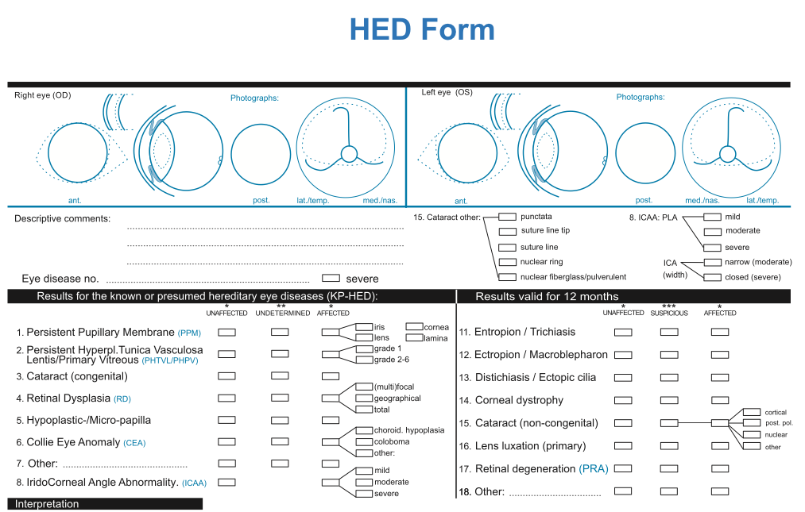
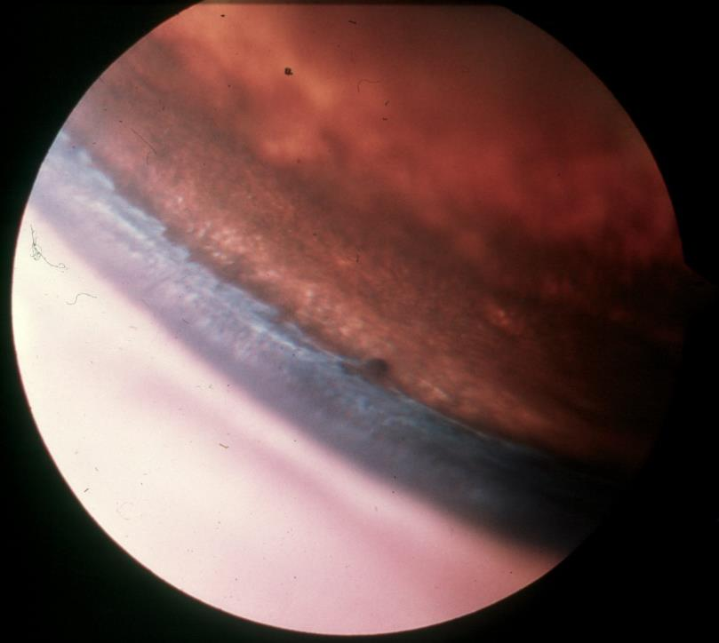
4. Gonioscopy, two year-old dog
Which box(es) should you tick on the ECVO certificate of eye examination form? (mark all boxes that apply)
8. ICAA PLA: severe
8. ICA (width): closed
8. IridoCorneal Angle Abnormality: severe
D. 8. IridoCorneal Angle Abnormality: moderate

